Slide 1
Knowledge Gained from NZ Job Rotation
Wellington
3.26 – 4.20, 2012

Slide 2
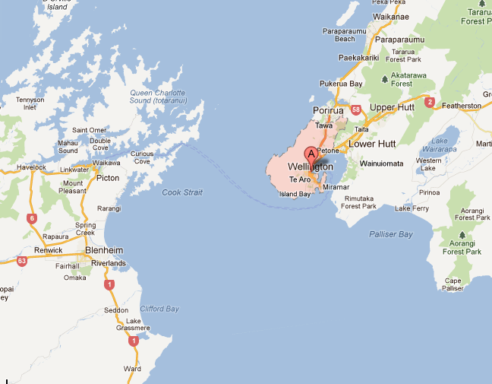
Wellington
New Zealand’s Capital
Southwestern tip of the North Island
2nd largest city (266 square kms, population: city 197,000, region 473,700)

Slide 3
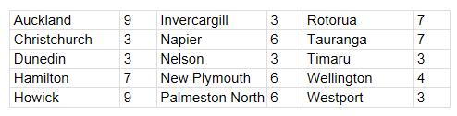
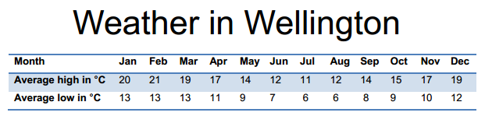
Wellington
Most companies/stores are open 9am – 6pm, but banking hours are different: 9am – 4:30pm
Wellington area code 04 (+64 4……)

Slide 4
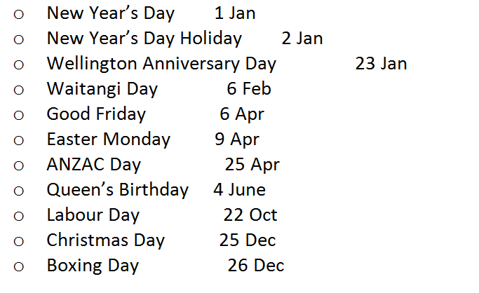
Wellington
Public holidays

Slide 5
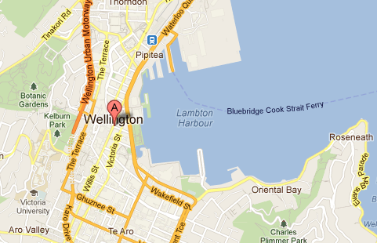
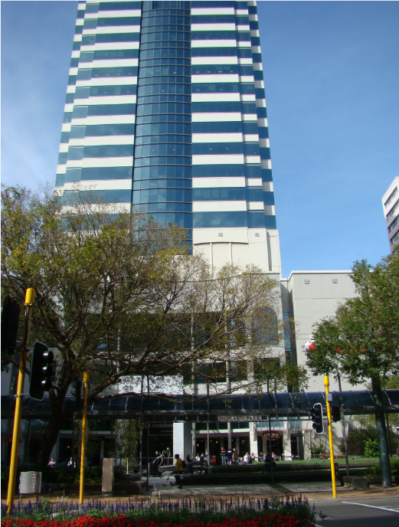
Microsoft Wellington Office

Slide 6
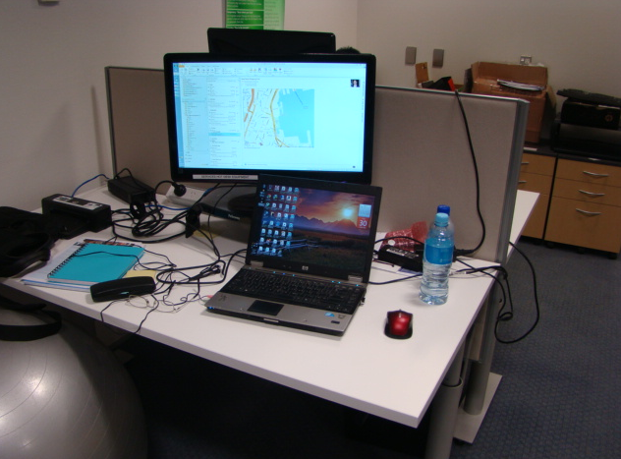
Microsoft Wellington Office

Slide 7
A Few things about MS Customers
Government customers
Not as many as the customers in Auckland
Bank of New Zealand
Legacy MS products, Lotus Notes
Team Leader in Wellington – Senior TAM Anthony Willis
Only 1 PFE - Sumit Kumar (PFE)

Slide 8
Feedback From TAM & Customers
Highlights:
Overall, TAM’s are satisfied with how case is handled from APGC CTS, in terms of both process and technical ability
Compliments were given to the engineers who helped solve SQL/SCCM issues

Slide 9
Feedback From TAM & Customers
Lowlights:
Due to time difference, communication is difficult sometimes. Some NZ customers often starts to work early. On Friday, people may leave office around 4:30pm
1 TAM mentioned he got requests couple of times from our engineers to change contact to TAM which is against policy.
Some customers thought that the assigned engineer handles 1 case at a time

Slide 10



Chatting with NZ customers…
Sliver Fern
Kiwi

Slide 11
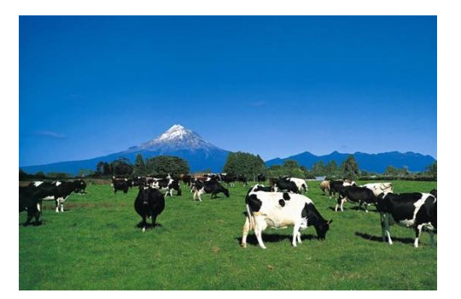
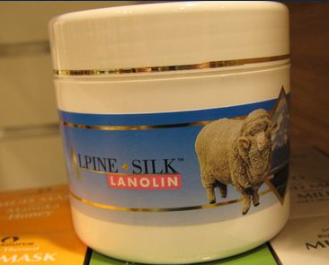

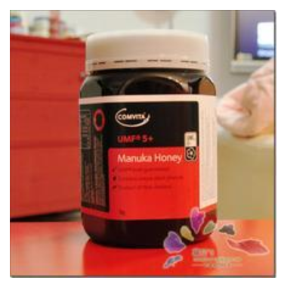

Chatting with NZ customers…
Manuka Honey

Slide 12
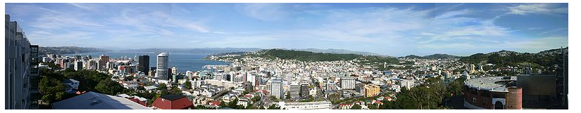
Thank You
Questions?

